Slide 1





openVirus
Scientific Knowledge for citizens in the time of COVID
TheContentMine and Others Presented by Peter Murray-Rust
Virtual, 2020-05-28
A new knowledgebase by/for citizens
pm286@cam.ac.uk
peter@contentmine.org
Images from ContentMine CC BY and Wikimedia CC BY-SA

Slide 2
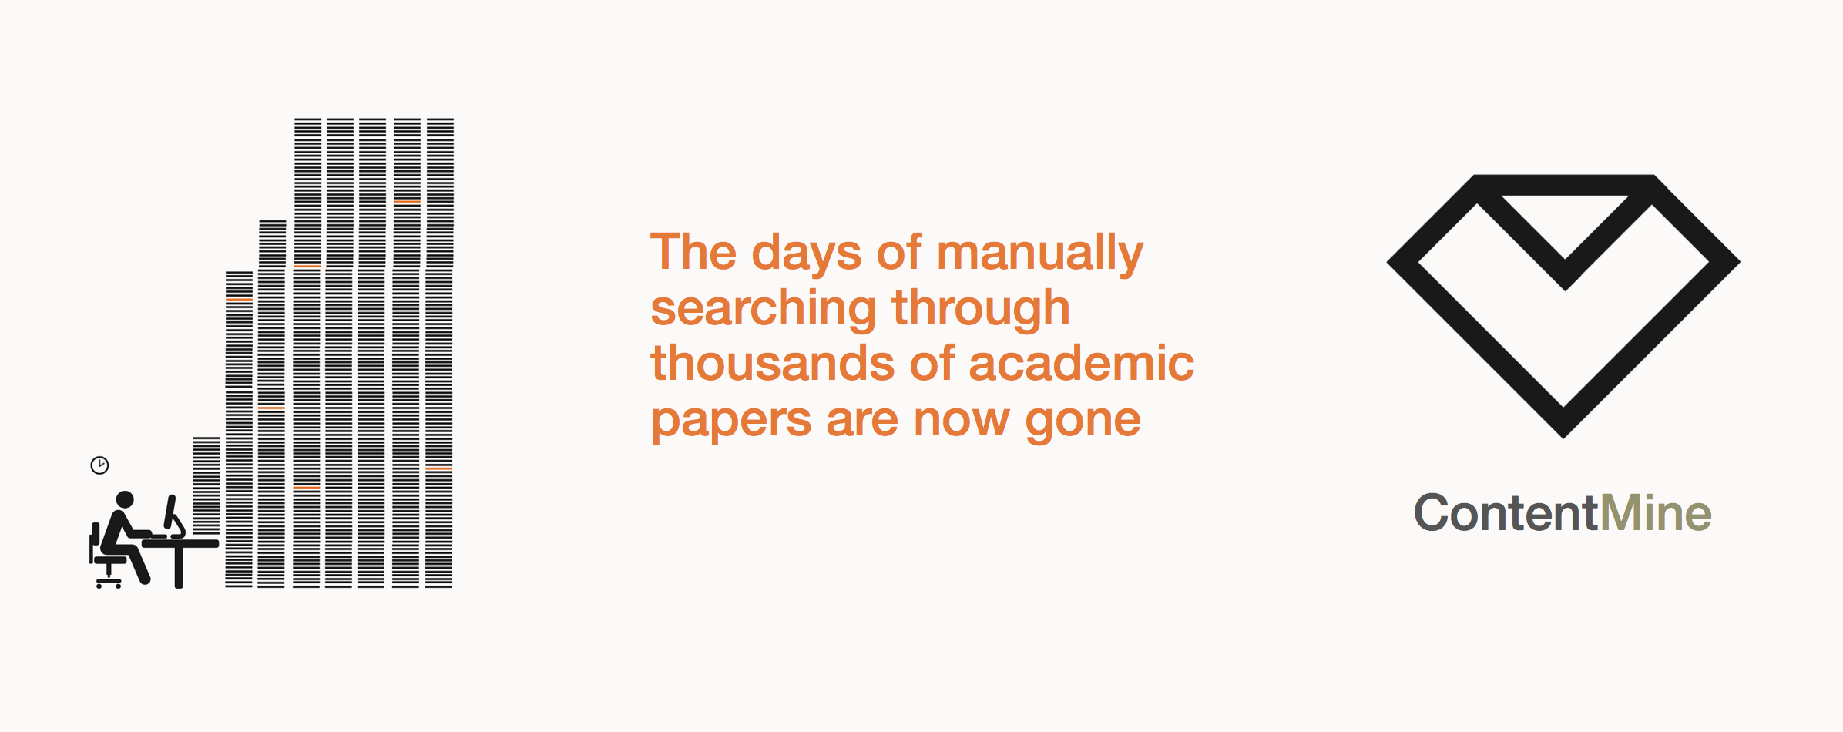
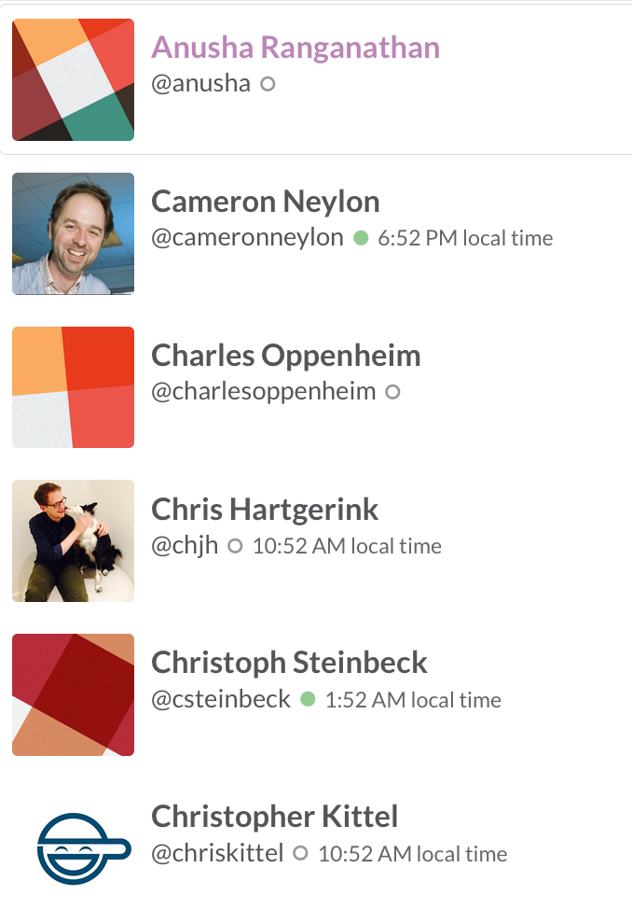
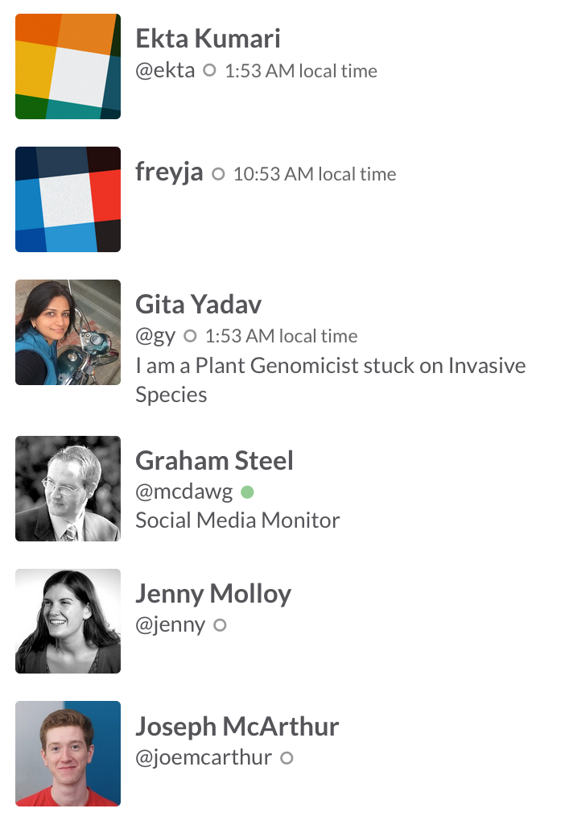
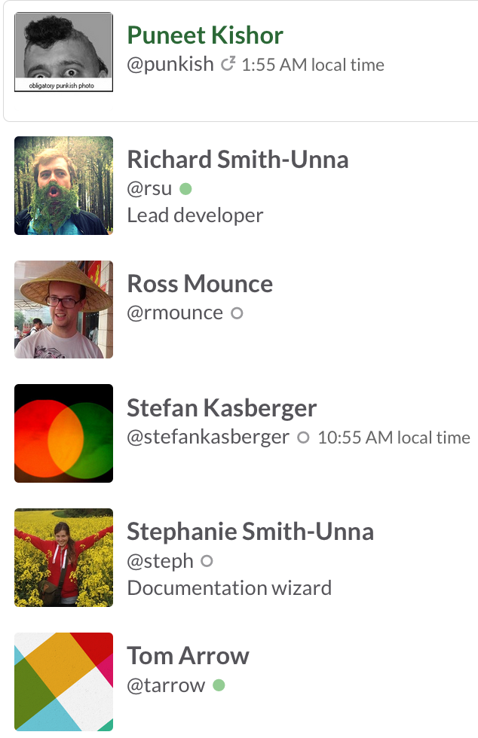
The Right to Read is the Right to Mine
Remko Popma,
Lezan Hawizy, Tim Voronov,
Andy Jackson,
Clyde Davies,
Thomas Shafee,
Priya JK , Kareena Singh,
Simon Worthington,
(2x digital music industry!)
ContentMine is OpenLocked Non-Profit http://contentmine.org

Slide 3
The world’s existential problems need knowledge
2019* we set up
“Open Climate Knowledge” (OCK)
to build tools to mine the scientific articles about climate change.
Why? 50-90% of all published science is behind PAYWALLS. And the rest is very hard to find…
*Simon Worthington and PMR

Slide 4
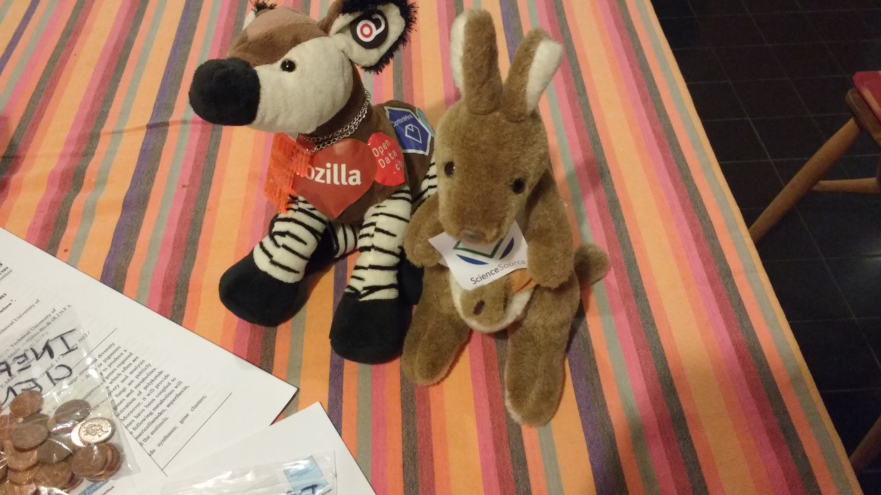
…and closed access means people die…
And 11,310 people died
I’m from Congo where Ebola comes from. The Liberia outbreak
Was predicted 30 years ago
…The software will demonstrate how we can search in future …

Slide 5
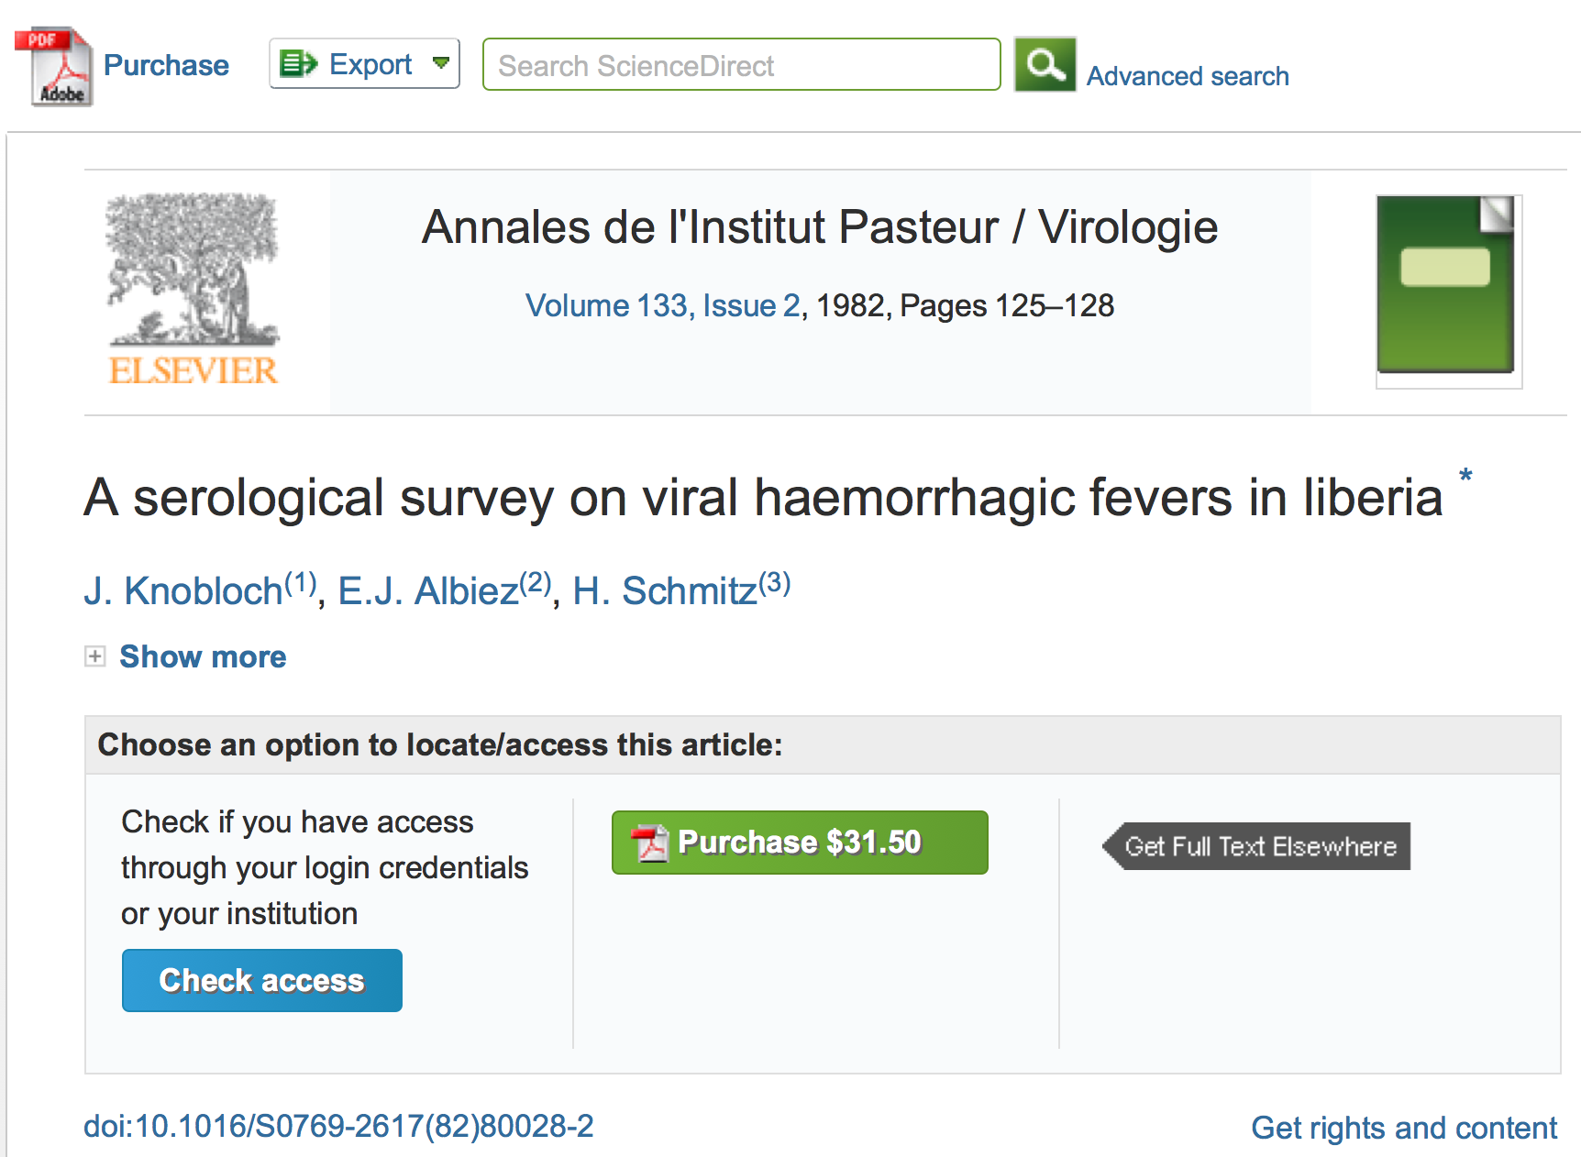
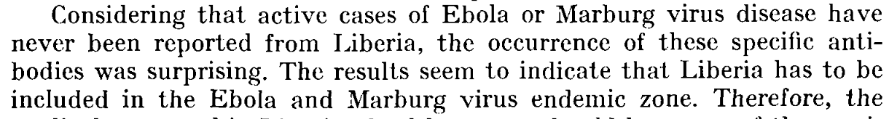
STILL PAYWALLED!

Slide 6
OCK -> openVirus
Let’s repurpose OCK tools for COVID:
Let’s create a volunteer openVirus community

Slide 7
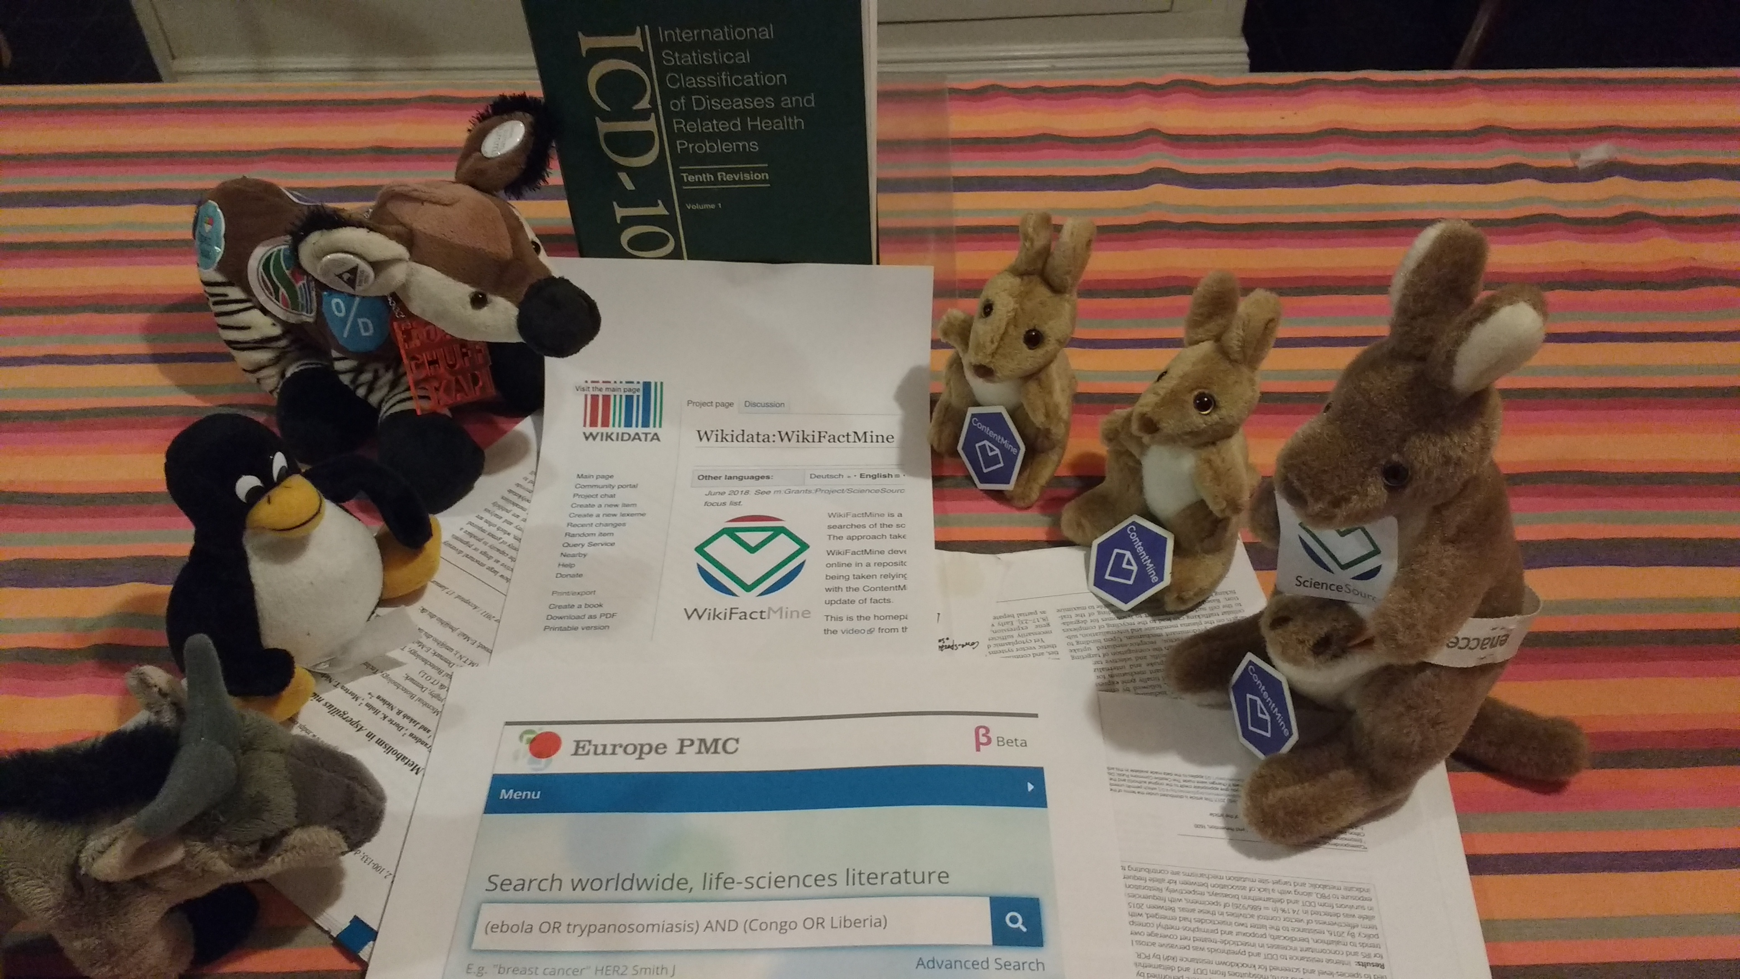
We can change all that!
Wikidata
PREPRINTS!!
Crossref
AMI
getpapers
EuropePMC
We can do everything ourselves! Look … demo

Slide 8
Mining!
build scrapers or API query tools for Openly readable sources.
query or scrape user questions
download raw content (PDF, HTML, images) - 10 - 10,000 articles
clean and semantify
annotate with dictionaries
expose , analyze, display.

Slide 9
*** getpapers runs FAST! Downloads 50 papers / sec => 3000 / min => 200,000 /hour
*** AMI-search:
Dictionaries based on Wikidata (50 million items!) …or build your own.
…country, brainparts, funders, disease, drugs, law, politics …
looking for feedback, volunteers, examples

Slide 10
Sources
EuropePMC.
biorxiv and medrxiv
DOAJ
EThOS
Redalyc (MX)
…

Slide 11
SOME TOOLS
framework: ami + CProject data
scrapers: getpapers, Ferret, curl, scrapy
cleaners: PDFBox, Tidy/Jsoup, etc. Grobid
transformers: xml2html, ami ocr, KNIME
dictionaries: ami dictionary
indexing and annotation: Solr, ami
Analysis and display: R, KNIME

Slide 12
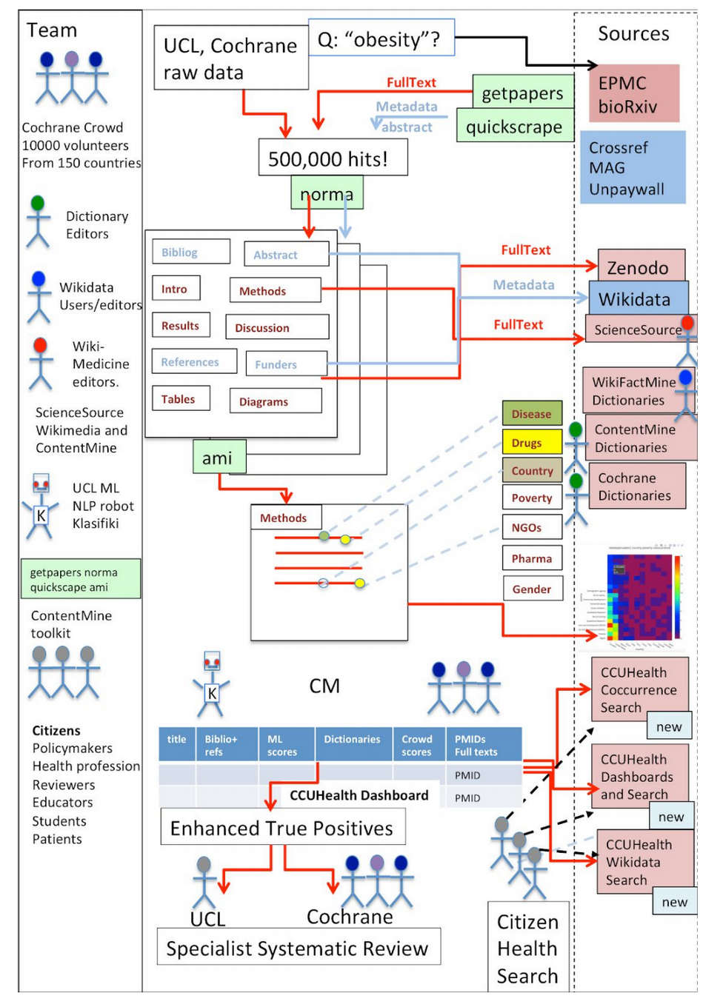
bioRxiv in Citizen Health Search (CHS)
A proposal to Wellcome Trust (
Open Research in Health call) with
ContentMine, Cochrane and UCL-EPPI (CCU)
CHS puts semantic search on the desktop
of the searcher. We index all the visible
Medical literature, normalize, section
and index against a bank of user-chosen
dictionaries.
CHS takes input from EPMC, bioRxiv and
emerging community sources such as
Crossref, unpaywall and outputs to Zenodo,
Wikidata and CM-Science Source.
Citizen Dashboard

Slide 13
Distributing openVirus
Toolkit
sources
dictionaries
tutorials
downloadable or even boxed

Slide 14
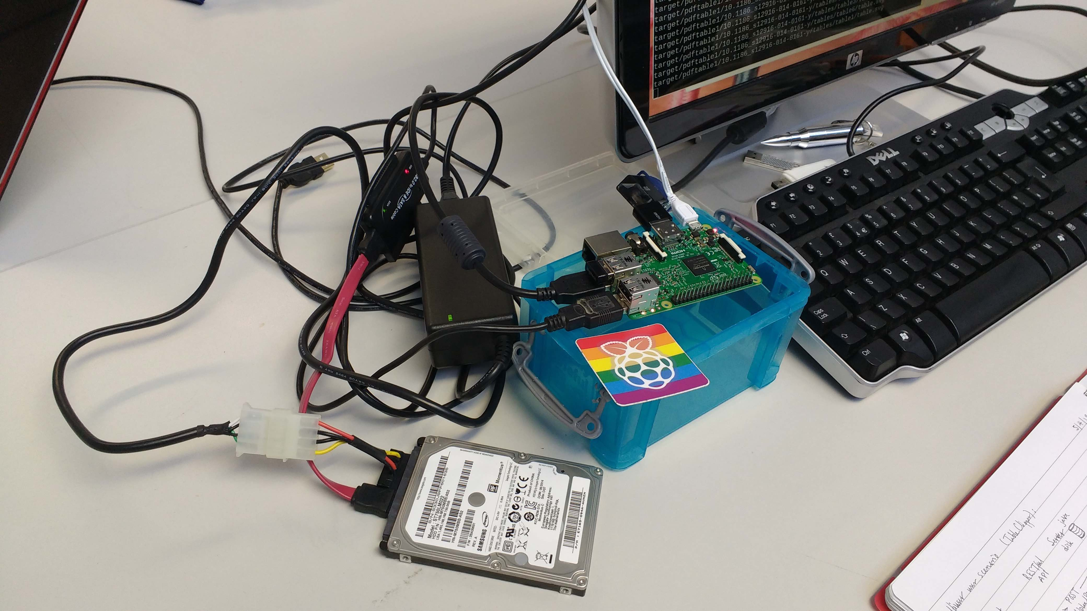
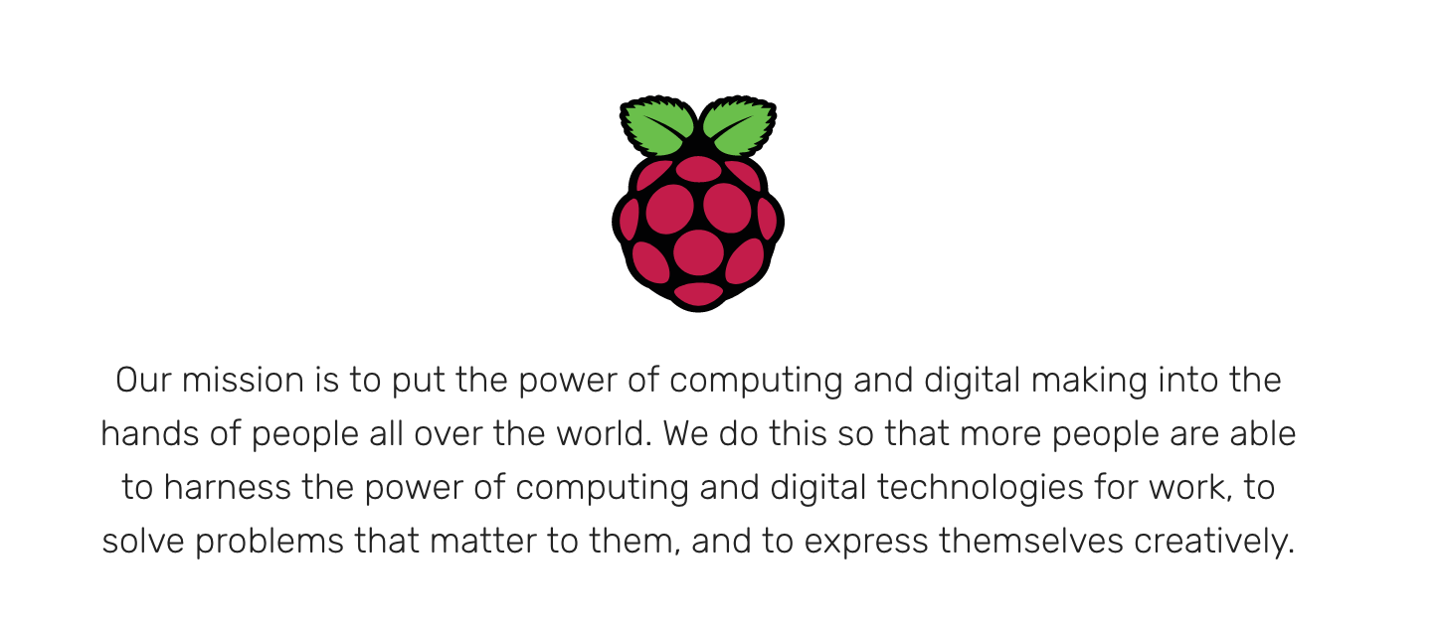
Power
Raspberry PI
Disk
All the world’s 5 million FAIR Open Scientific articles (* 0.1 MB = 0.5 TB), indexed by ContentMine . Disk 30 GBP Raspberry Pi3. 50 GBP
CC BY, PeterMR

Slide 15
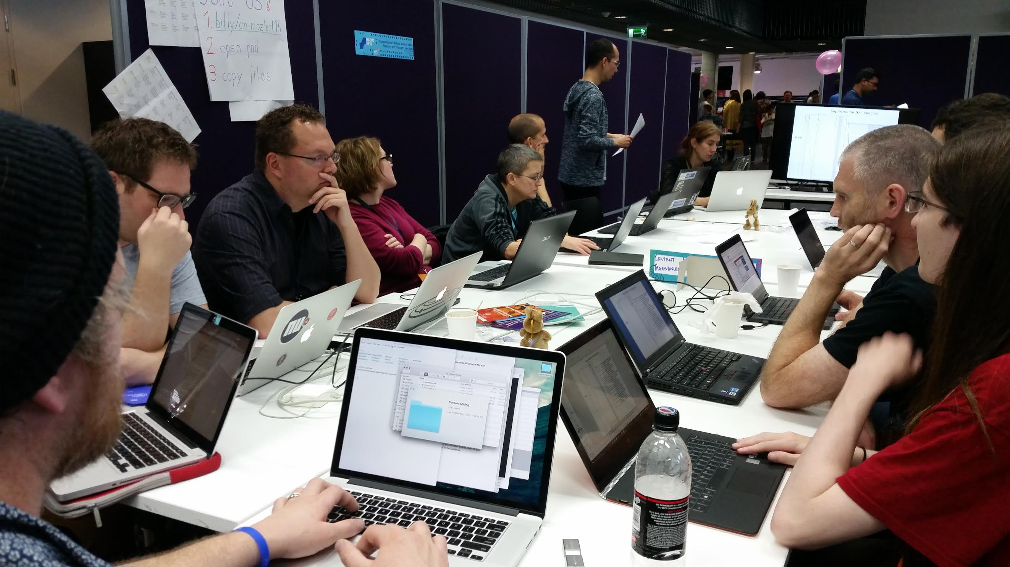
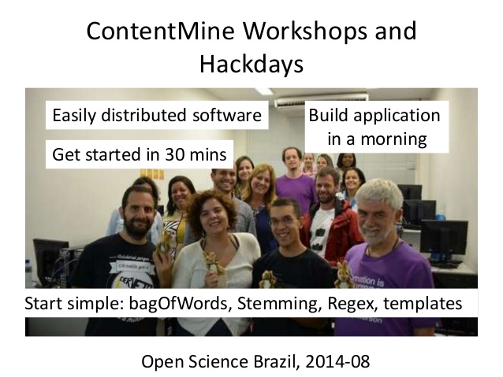
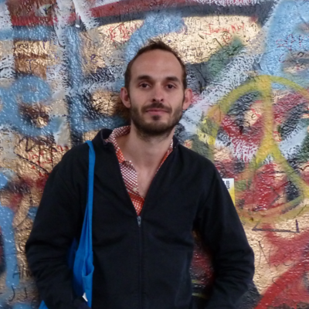
Chris Kittel, CM, atMozfest 2015
Stefan Kasberger, CM
ContentMine Workshops on Mining

Slide 16
Dehli, IN
Priya and Kareena working as 3rd year interns on

Slide 17
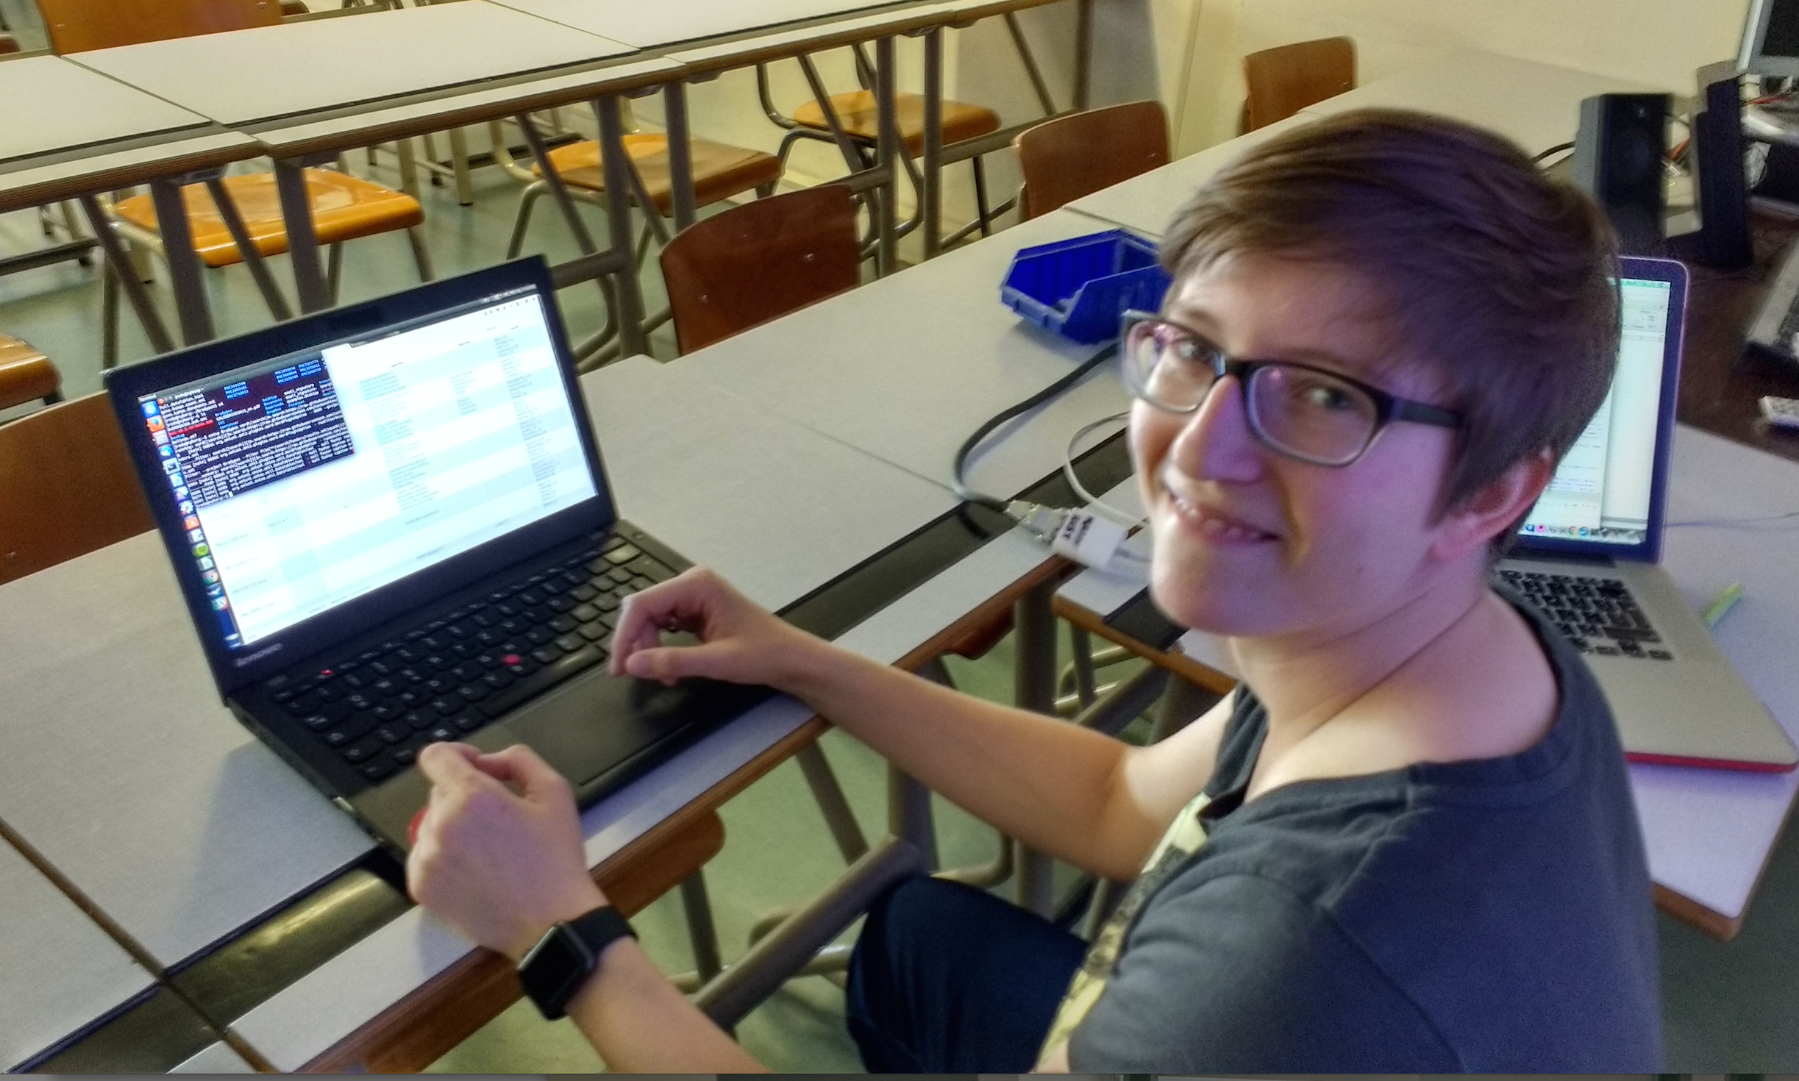
Julia Reda, Pirate MEP, running ContentMine software to liberate science 2016-04-16

Slide 18
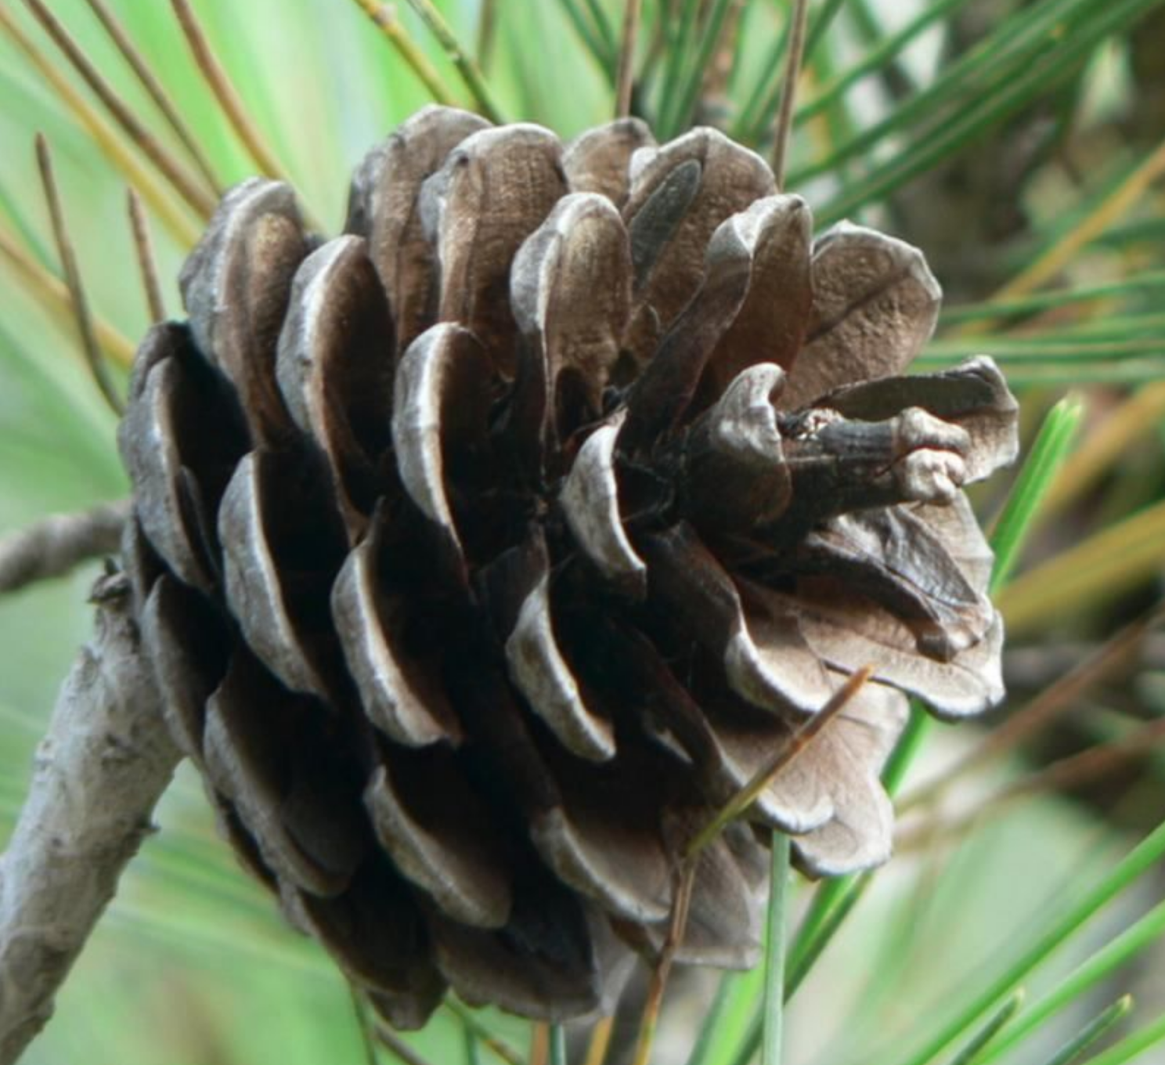

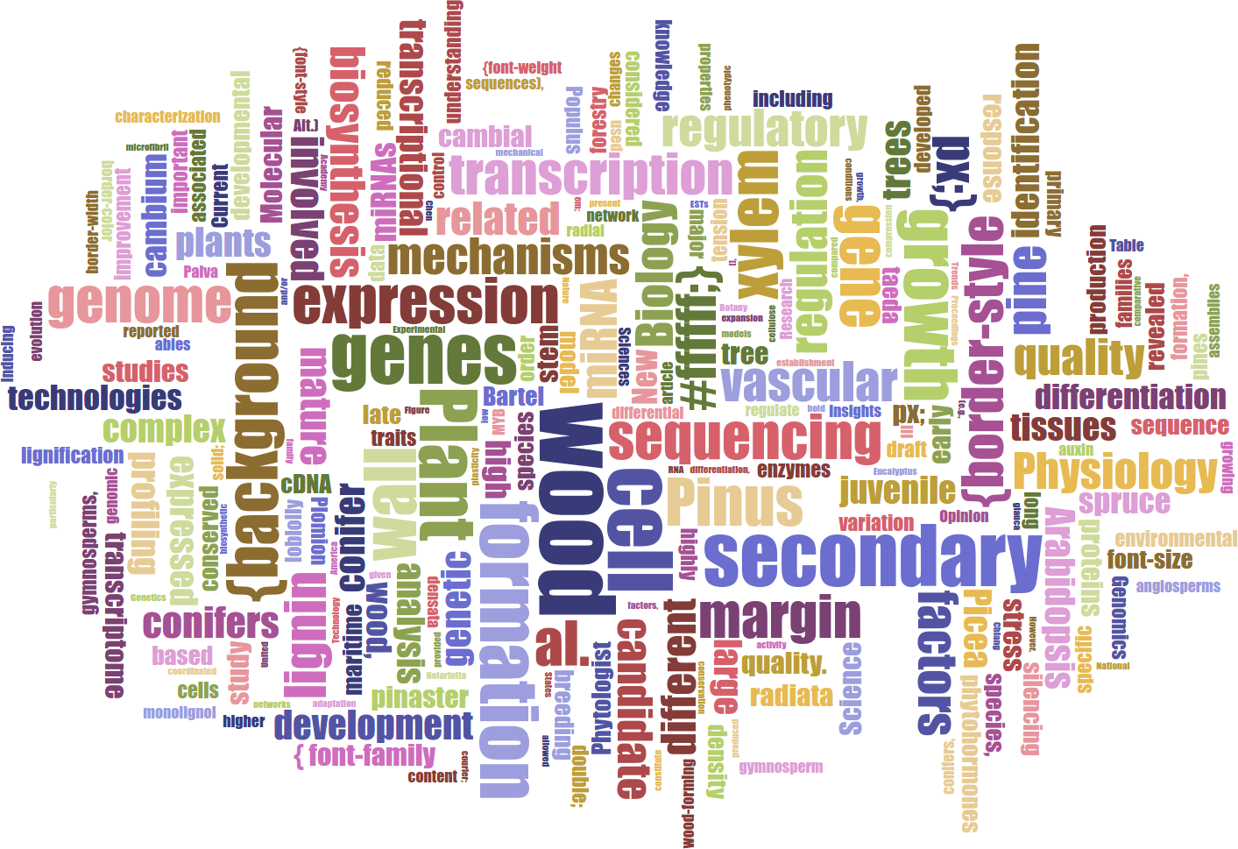
Lars Willighagen
15 years old NL
Wants: extract data about conifers (relations to chemicals, height etc.)
Outcome: database with webpage containing conifer properties
Table Facts Visualiser DEMO
Card DEMO
Word Cloud
„ I applied to this fellowship to learn new things and combine the ContentMine with two previous projects I never got to finish, and I got really excited by the idea and the ContentMine at large.“

Slide 19
http://www.budapestopenaccessinitiative.org/read
… an unprecedented public good. …
… completely free and unrestricted access to [peer-reviewed literature] by all scientists, scholars, teachers, students, and other curious minds. …
…Removing access barriers to this literature will accelerate research, enrich education, share the learning of the rich with the poor and the poor with the rich, make this literature as useful as it can be, and lay the foundation for uniting humanity in a common intellectual conversation and quest for knowledge.
(Budapest Open Access Initiative, 2003)

Slide 20
Contentmine.org. Join us! We need…
QUERIES
TESTERS!!
GRAPHICS
SOFTWARE
SCRAPERS
DOCUMENTING
http://github.com/petermr/openVirus

